Slide 1
Applied Cryptography ECB, CBC, OFB, CTR, CFB, message integrity, hash family, preimage resistant, second preimage resistant, collision resistant
Liangfeng Zhang
School of Information Science and Technology
ShanghaiTech University

Slide 2
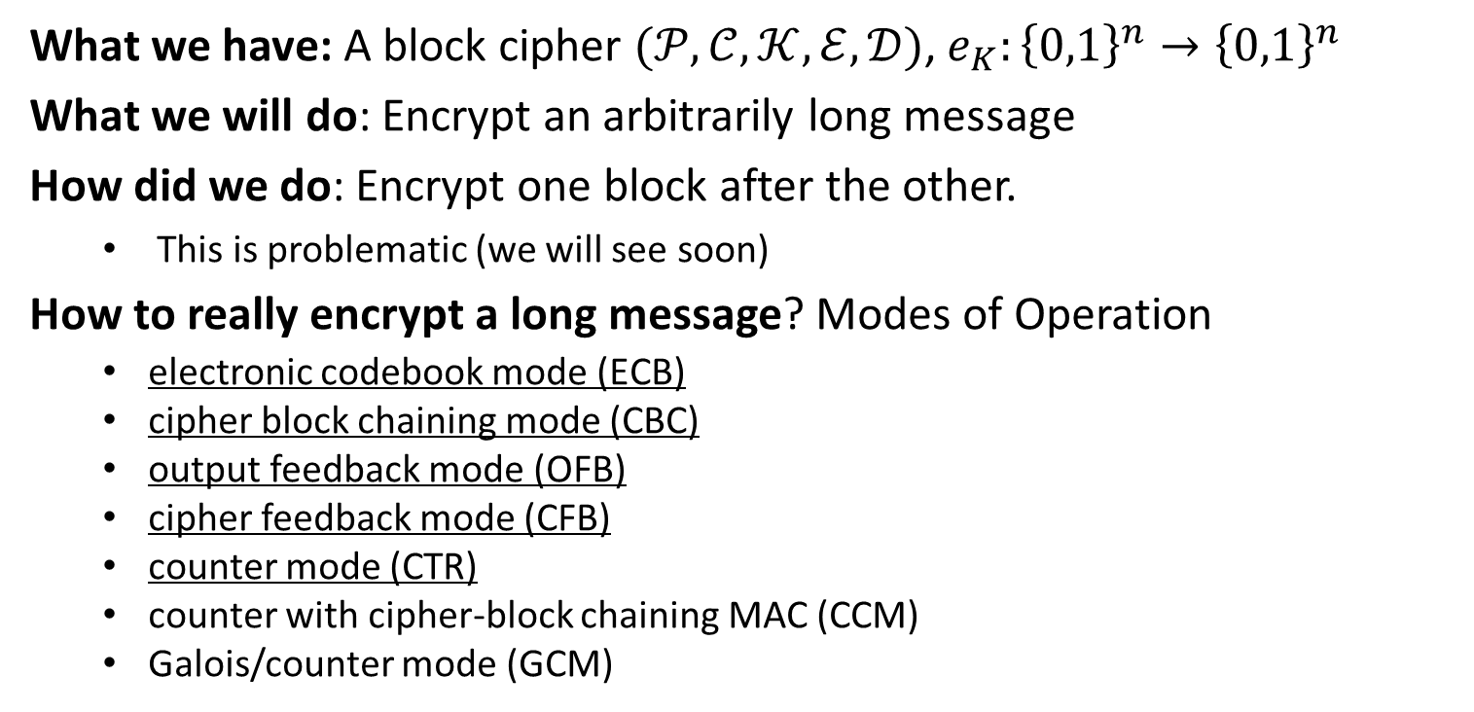
Modes of Operation
What we have: A block cipher $(𝒫,𝒞,𝒦,ℰ,𝒟)$, $e_{K}:{\left\{0,1\right\}}^{n}→{\left\{0,1\right\}}^{n}$
What we will do: Encrypt an arbitrarily long message
How did we do: Encrypt one block after the other.
This is problematic (we will see soon)
How to really encrypt a long message? Modes of Operation
electronic codebook mode (ECB)
cipher block chaining mode (CBC)
output feedback mode (OFB)
cipher feedback mode (CFB)
counter mode (CTR)
counter with cipher-block chaining MAC (CCM)
Galois/counter mode (GCM)

Slide 3

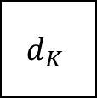








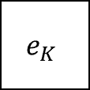



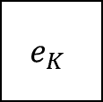

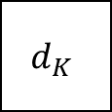
ECB
Block cipher $\left(𝓟,𝓒,𝓚,𝓔,𝓓\right).$ $e_{K}:{\left\{0,1\right\}}^{n}→{\left\{0,1\right\}}^{n}$ is an encryption rule
$$x_{1}$$
$$x_{2}$$
$$x_{3}$$
$$y_{1}$$
$$y_{2}$$
$$y_{3}$$
$$e_{K}$$
$$e_{K}$$
$$e_{K}$$
$$d_{K}$$
$$d_{K}$$
$$d_{K}$$
$$y_{1}$$
$$y_{2}$$
$$y_{3}$$
$$x_{1}$$
$$x_{2}$$
$$x_{3}$$
ECB Encryption
ECB Decryption
Analysis: Identical Plaintext Blocks $⇒$ Identical Ciphertext Blocks
Should never be used in practice

Slide 4

























CBC
Block cipher $\left(𝓟,𝓒,𝓚,𝓔,𝓓\right).$ $e_{K}:{\left\{0,1\right\}}^{n}→{\left\{0,1\right\}}^{n}$ is an encryption rule
$$x_{1}$$
$$x_{2}$$
$$x_{3}$$
$$IV$$
$$y_{1}$$
$$y_{2}$$
$$y_{3}$$
$$IV$$
$$⨁$$
$$⨁$$
$$⨁$$
$$e_{K}$$
$$e_{K}$$
$$e_{K}$$
$$d_{K}$$
$$d_{K}$$
$$d_{K}$$
$$⨁$$
$$⨁$$
$$⨁$$
$$IV$$
$$y_{1}$$
$$y_{2}$$
$$y_{3}$$
$$x_{1}$$
$$x_{2}$$
$$x_{3}$$
CBC Encryption
CBC Decryption
Remark: initialization vector (IV) should be randomly chosen every time
Never use the same IV

Slide 5














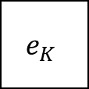










OFB
Block cipher $\left(𝓟,𝓒,𝓚,𝓔,𝓓\right).$ $e_{K}:{\left\{0,1\right\}}^{n}→{\left\{0,1\right\}}^{n}$ is an encryption rule
$$IV$$
$$e_{K}$$
$$e_{K}$$
$$e_{K}$$
$$e_{K}$$
$$e_{K}$$
$$e_{K}$$
$$x_{1}$$
$$⨁$$
$$x_{2}$$
$$⨁$$
$$x_{3}$$
$$⨁$$
$$IV$$
$$y_{1}$$
$$⨁$$
$$y_{2}$$
$$⨁$$
$$y_{3}$$
$$⨁$$
$$IV$$
$$y_{1}$$
$$y_{2}$$
$$y_{3}$$
$$x_{1}$$
$$x_{2}$$
$$x_{3}$$
OFB Encryption
OFB Decryption
Remark: initialization vector (IV) should be never reused.

Slide 6











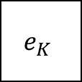





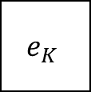







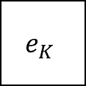






CTR
Block cipher $\left(𝓟,𝓒,𝓚,𝓔,𝓓\right).$ $e_{K}:{\left\{0,1\right\}}^{n}→{\left\{0,1\right\}}^{n}$ is an encryption rule
$$ctr$$
$$ctr+1$$
$$ctr+2$$
$$ctr+3$$
$$ctr$$
$$ctr+1$$
$$ctr+2$$
$$ctr+3$$
$$e_{K}$$
$$e_{K}$$
$$e_{K}$$
$$e_{K}$$
$$e_{K}$$
$$e_{K}$$
$$x_{1}$$
$$⨁$$
$$x_{2}$$
$$⨁$$
$$x_{3}$$
$$⨁$$
$$ctr$$
$$y_{1}$$
$$⨁$$
$$y_{2}$$
$$⨁$$
$$y_{3}$$
$$⨁$$
$$ctr$$
$$y_{1}$$
$$y_{2}$$
$$y_{3}$$
$$x_{1}$$
$$x_{2}$$
$$x_{3}$$
CTR Encryption
CTR Decryption
Analysis: The encryption and decryption can be parallelized.

Slide 7












CFB
Block cipher $\left(𝓟,𝓒,𝓚,𝓔,𝓓\right).$ $e_{K}:{\left\{0,1\right\}}^{n}→{\left\{0,1\right\}}^{n}$ is an encryption rule
$$IV$$
$$e_{K}$$
$$e_{K}$$
$$e_{K}$$
$$e_{K}$$
$$e_{K}$$
$$e_{K}$$
$$x_{1}$$
$$⨁$$
$$x_{2}$$
$$⨁$$
$$x_{3}$$
$$⨁$$
$$IV$$
$$⨁$$
$$y_{1}$$
$$⨁$$
$$y_{2}$$
$$⨁$$
$$y_{3}$$
$$IV$$
$$y_{1}$$
$$y_{2}$$
$$y_{3}$$
$$x_{1}$$
$$x_{2}$$
$$x_{3}$$
CFB Encryption
CFB Decryption
Analysis: Same as OFB except that $e_{K}$ is applied to the ciphertext blocks

Slide 9



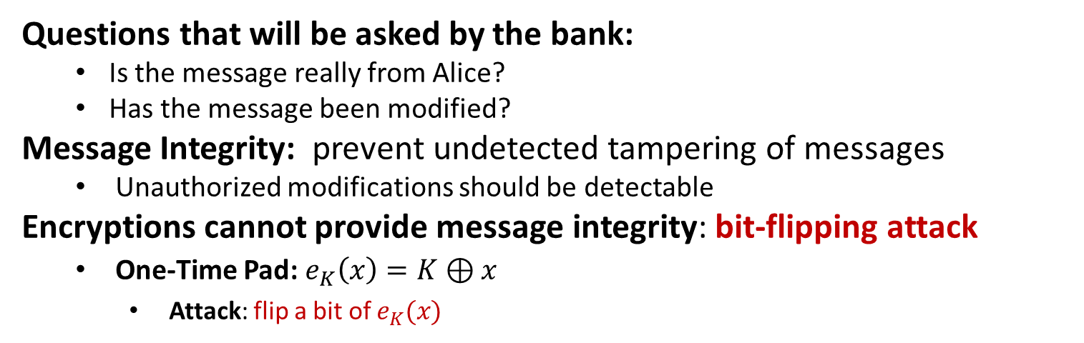
Message Integrity
Transfer $1000 from Alice’s account to Bob’s
$$Alice$$
Questions that will be asked by the bank:
Is the message really from Alice?
Has the message been modified?
Message Integrity: prevent undetected tampering of messages
Unauthorized modifications should be detectable
Encryptions cannot provide message integrity: bit-flipping attack
One-Time Pad: $e_{K}\left(x\right)=K⊕x$
Attack: flip a bit of $e_{K}(x)$

Slide 10















Confidentiality $⇏$ Integrity
OFB: $e_{K}$ is an encryption rule in a block cipher
$$IV$$
$$e_{K}$$
$$e_{K}$$
$$e_{K}$$
$$x_{1}$$
$$⨁$$
$$x_{2}$$
$$⨁$$
$$x_{3}$$
$$⨁$$
$$IV$$
$$y_{1}$$
$$y_{2}$$
$$y_{3}$$
Attack: flip a bit of any of ciphertext blocks $y_{1},y_{2},y_{3}$
the same bit (location) of the message will be flipped, without being detected

Slide 11

















Confidentiality $⇏$ Integrity
CTR: $e_{K}$ is an encryption rule in a block cipher
$$ctr$$
$$ctr+1$$
$$ctr+2$$
$$ctr+3$$
$$e_{K}$$
$$e_{K}$$
$$e_{K}$$
$$x_{1}$$
$$⨁$$
$$x_{2}$$
$$⨁$$
$$x_{3}$$
$$⨁$$
$$ctr$$
$$y_{1}$$
$$y_{2}$$
$$y_{3}$$
Attack: flip a bit of any of ciphertext blocks $y_{1},y_{2},y_{3}$
the same bit (location) of the message will be flipped, without being detected

Slide 12








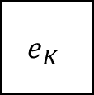





Confidentiality $⇏$ Integrity
CBC: $e_{K}$ is an encryption rule in a block cipher
$$x_{1}$$
$$x_{2}$$
$$x_{3}$$
$$IV$$
$$⨁$$
$$⨁$$
$$⨁$$
$$e_{K}$$
$$e_{K}$$
$$e_{K}$$
$$IV$$
$$y_{1}$$
$$y_{2}$$
$$y_{3}$$
Attack: flip a bit of the initial vector $IV$
The same bit (location) of $x_{1}$ will be flipped, without being detected

Slide 13







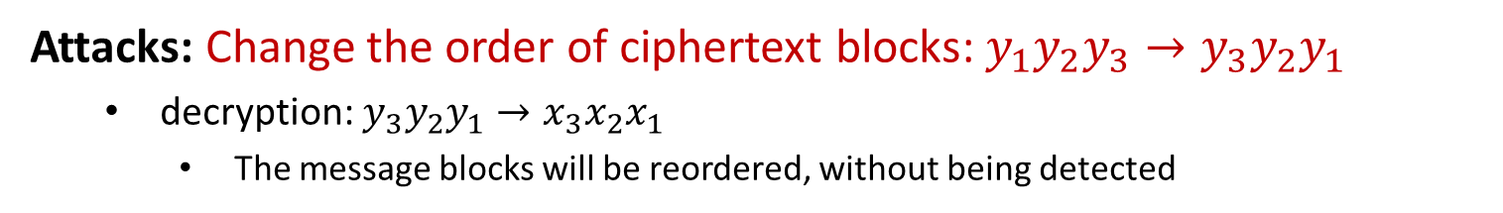

Confidentiality $⇏$ Integrity
ECB: $e_{K}$ is an encryption rule in a block cipher
$$x_{1}$$
$$x_{2}$$
$$x_{3}$$
$$e_{K}$$
$$e_{K}$$
$$e_{K}$$
$$y_{1}$$
$$y_{2}$$
$$y_{3}$$
Attacks: Change the order of ciphertext blocks: $y_{1}y_{2}y_{3}→y_{3}y_{2}y_{1}$
decryption: $y_{3}y_{2}y_{1}→x_{3}x_{2}x_{1}$
The message blocks will be reordered, without being detected

Slide 14








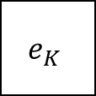





Confidentiality $⇏$ Integrity
Block cipher $\left(𝓟,𝓒,𝓚,𝓔,𝓓\right).$ $e_{K}:{\left\{0,1\right\}}^{n}→{\left\{0,1\right\}}^{n}$ is an encryption rule
$$IV$$
$$e_{K}$$
$$e_{K}$$
$$e_{K}$$
$$x_{1}$$
$$⨁$$
$$x_{2}$$
$$⨁$$
$$x_{3}$$
$$⨁$$
$$IV$$
$$y_{1}$$
$$y_{2}$$
$$y_{3}$$
Attack: flip a bit of $y_{1}$
the same bit (location) of the message will be flipped, without being detected

Slide 16
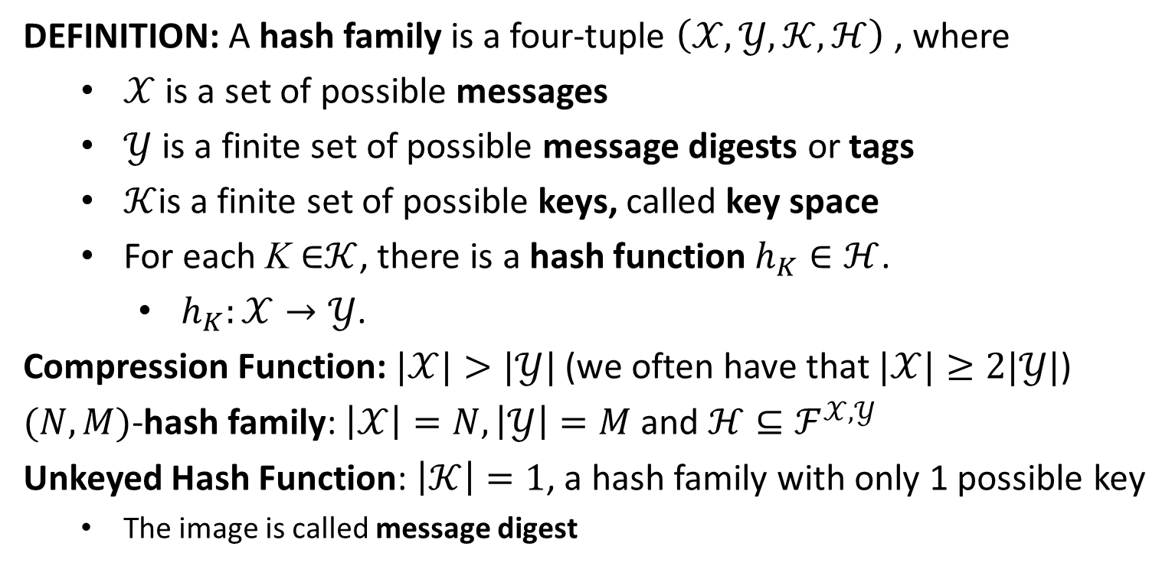
Hash Family
DEFINITION: A hash family is a four-tuple $\left(𝒳,𝒴,𝒦,ℋ\right)$ , where
$𝒳$ is a set of possible messages
$𝒴$ is a finite set of possible message digests or tags
$𝒦$is a finite set of possible keys, called key space
For each $\text{K} \text{∈}𝒦$, there is a hash function $h_{K}∈ℋ$.
$h_{K}:𝒳→𝒴$.
Compression Function: $|𝒳|>|𝒴|$ (we often have that $|𝒳|≥2|𝒴|$)
$(N,M)$-hash family: $\left|𝒳\right|=N,\left|𝒴\right|=M$ and $ℋ⊆ℱ^{𝒳,𝒴}$
Unkeyed Hash Function: $\left|𝒦\right|=1$, a hash family with only 1 possible key
The image is called message digest

Slide 17
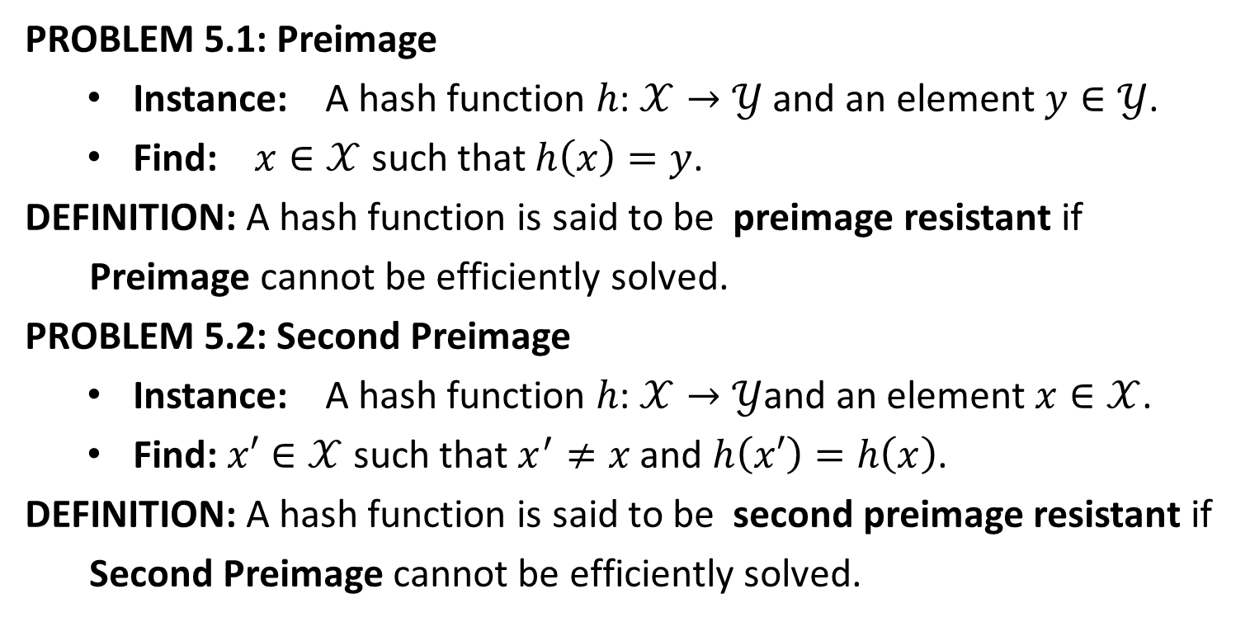
Security of Hash Functions
PROBLEM 5.1: Preimage
Instance: A hash function $h\text{:} 𝒳→𝒴$ and an element $y∈𝒴$.
Find: $x∈𝒳$ such that $h\left(x\right)=y$.
DEFINITION: A hash function is said to be preimage resistant if
Preimage cannot be efficiently solved.
PROBLEM 5.2: Second Preimage
Instance: A hash function $h\text{:} 𝒳→𝒴$and an element $x∈𝒳$.
Find:$x′∈𝒳$ such that $x^{′}≠x$ and $h\left(x′\right)=h\left(x\right)$.
DEFINITION: A hash function is said to be second preimage resistant if
Second Preimage cannot be efficiently solved.

Slide 18
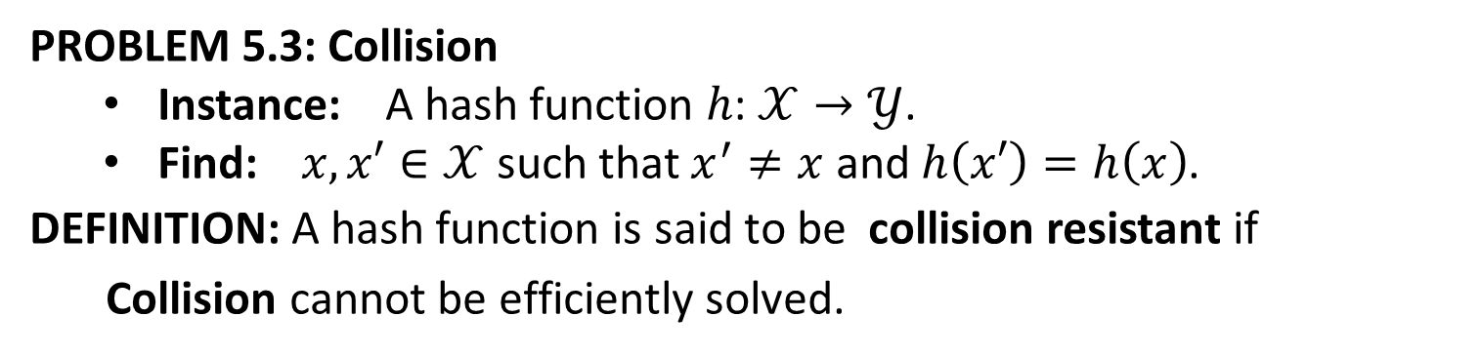
Security of Hash Functions
PROBLEM 5.3: Collision
Instance: A hash function $h\text{:} 𝒳→𝒴$.
Find: $x,x′∈𝒳$ such that $x^{′}≠x$ and $h\left(x′\right)=h\left(x\right)$.
DEFINITION: A hash function is said to be collision resistant if
Collision cannot be efficiently solved.

Slide 20

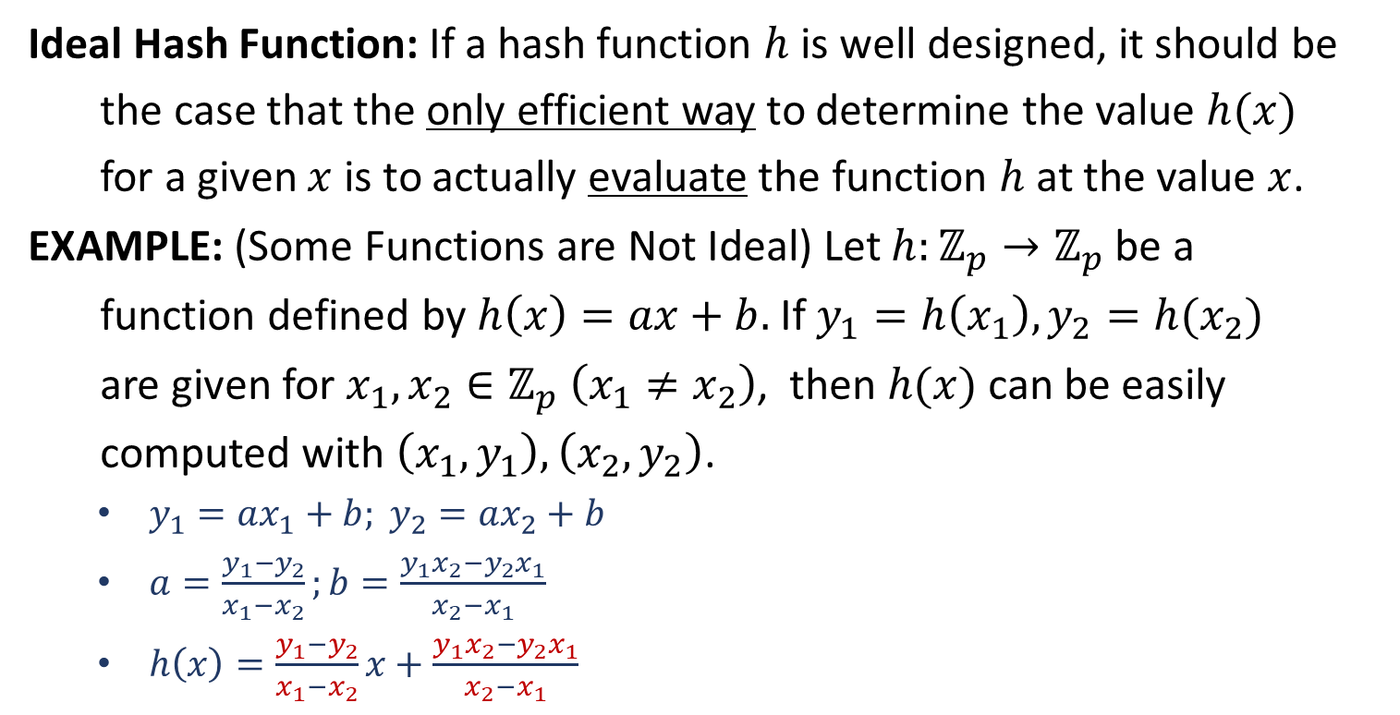


Random Oracle Model
Ideal Hash Function: If a hash function $h$ is well designed, it should be
the case that the only efficient way to determine the value $h(x)$
for a given $x$ is to actually evaluate the function $h$ at the value $x$.
EXAMPLE: (Some Functions are Not Ideal) Let $h:ℤ_{p}→ℤ_{p}$ be a
function defined by $h\left(x\right)=ax+b.$ If $y_{1}=h\left(x_{1}\right), y_{2}=h(x_{2})$
are given for $x_{1},x_{2}∈ℤ_{p} \left(x_{1}≠x_{2}\right)$, then $h(x)$ can be easily
computed with $\left(x_{1},y_{1}\right),\left(x_{2},y_{2}\right)$.
$y_{1}=ax_{1}+b; y_{2}=ax_{2}+b$
$a=\frac{y_{1}−y_{2}}{x_{1}−x_{2}};b=\frac{y_{1}x_{2}−y_{2}x_{1}}{x_{2}−x_{1}}$
$h\left(x\right)=\frac{y_{1}−y_{2}}{x_{1}−x_{2}}x+\frac{y_{1}x_{2}−y_{2}x_{1}}{x_{2}−x_{1}}$
$$h(x_{1})$$
$$h(x)$$
$$h(x_{2})$$
This is bad as a hash function!

